Slide 1
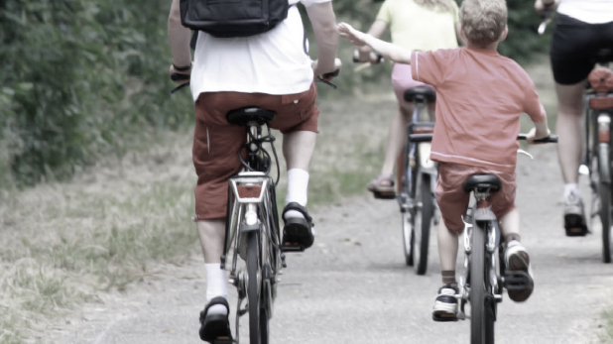
TRANSPORT DURING THE CORONA LOCKDOWN
– new potentials for transport modes among Danes?
A survey compiled by the Coordination for Gender Research in collaboration with the European TinnGO project

Slide 2
SAMPLE AND REPRESENTATION
Respondents (n=595) were recruited through
  facebook campaign boosts
  facebook local group pages
  a range of municipalities’ websites and facebook pages
Relatively skewed sample
  significantly more women (70 % women, 29 % men, 1 % other)
  significantly longer educated persons
  on average significant younger persons, especially 26-65 year olds are represented in the sample and in lesser degree the most young and old.

Slide 3
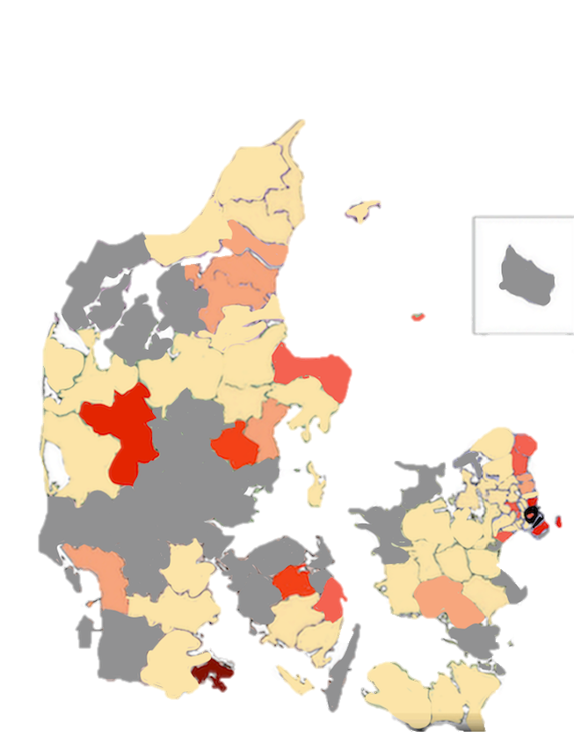
Sample represented in 68 municipalities
0
> 5
> 10
> 20
> 30
> 50
100+

Slide 4
STUDY DESIGN
We have used an explorative approach to data
To account for false positives we use a 0.05 indication level and 0.005 significance level when testing correlation.^{1,2}
Weights have been added on gender and education when documenting transport modes.
¹Wasserstein, Ronald L., og Nicole A. Lazar. 2016. “The ASA Statement on p -Values: Context, Process, and Purpose”. The American Statistician 70(2):129–33.
²Benjamin, Daniel J. et. al. 2018. “Redefine Statistical Significance.” Nature Human Behaviour 2(1):6–10.

Slide 5
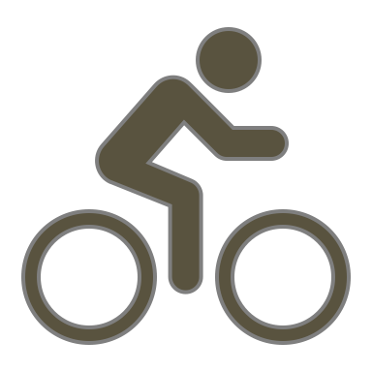
NON-MOTORIZED TRANSPORT MODES YIELD IN USE
- People have used non-motorized transport more during the Corona lockdown
- This makes room for change: 48 % of the persons that have walked a bit or much more, are willing to continue the new habit.
- The same goes for 72 % of the persons that have biked more during the Corona lockdown
- A challenge is to make collective transport a desirable choice again once the Corona virus is not a risk anymore.
Note: *Weights corresponding to the share of sex and education in the population, **respondents: by foot (496), own bike (404), own car (344), local public transport (382), regional train (282), ***the response category ”not relevant” has been coded as missing.

Slide 6
Danes prefer to travel more by bike and less by local public transport
Note: * Weights corresponding to the share of sex and education in the population, **the respondents could choose maximum two from nine categories, and the answers do not therefore correspond with the total number of respondents , ***total respondents in daily transport before the Corona lockdown (864), and preferred transport mode in the future (898).

Slide 7


LIVING AREA
We see an indicative difference in the changed use of local public transport on living area
The p-value is too high, and more data on rural area is needed
Note: *Weights corresponding to the share of sex and education in the population, ** respondents: rural area (21), town (102), bigger city (258) ***the response category ”not relevant” has been coded as missing, ****A chi²⁻test (critical value: 19.089) shows an indicative, but not significant difference in living area on the change of use in local public transport, *****p-value 0.014.

Slide 8
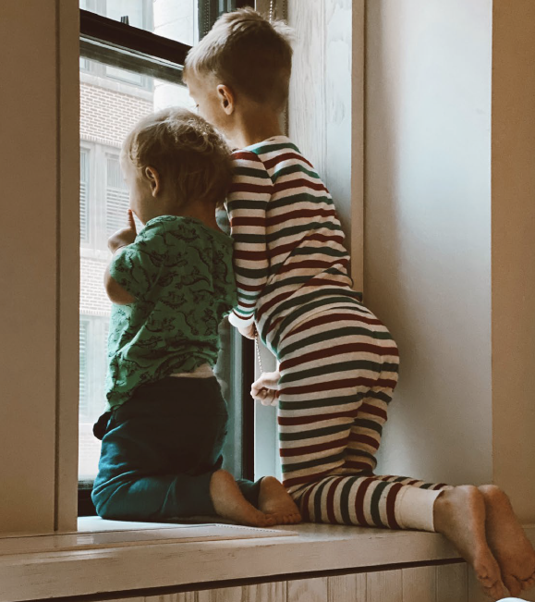
GENDER AND TRANSPORT
This survey does not indicate that the Corona lockdown have made transport frequency and mode more unequal between men and women.
No difference among men and women in choice of the two most used transport modes before the Corona lockdown or in their preferred future transport mode.
No difference in how often men and women travelled to work or studies before the Corona lockdown, or whether they travel more or less to work or studies during the Corona lockdown.

